Slide 1
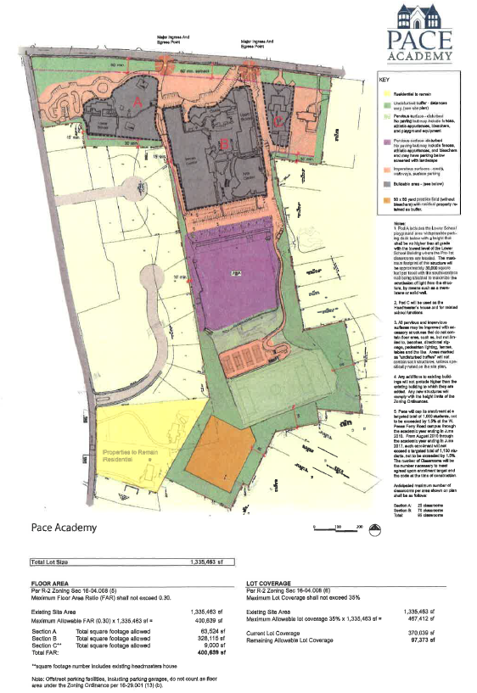

Slide 2
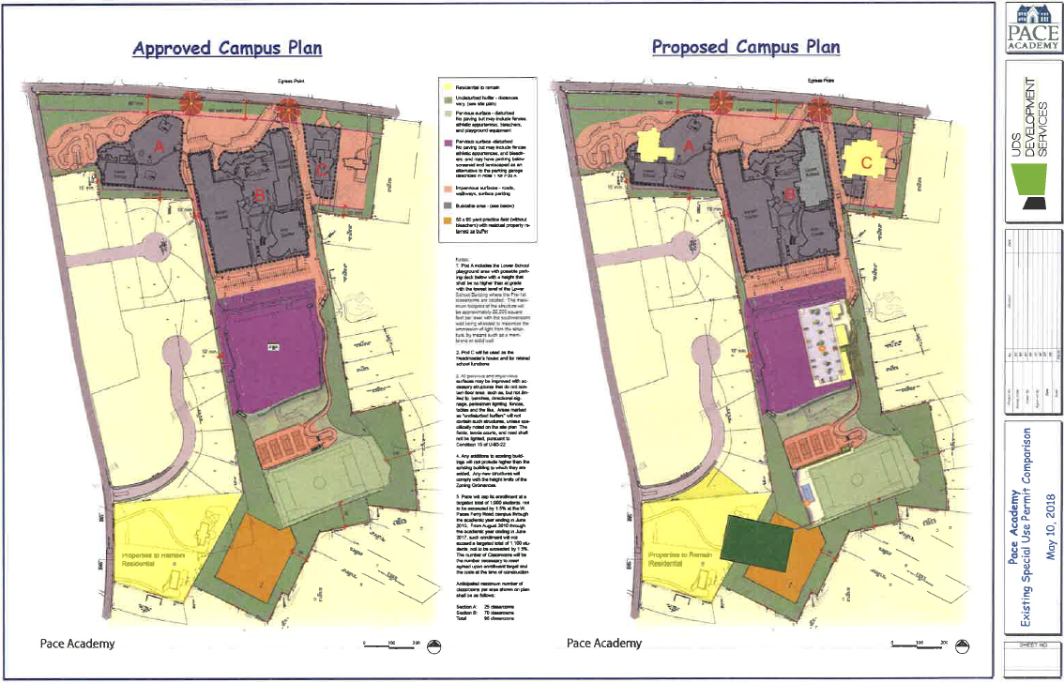

Slide 3
Changes to Pace Master Campus Plan
1. Pod A
Tear down Randall House, build new Lower School building in its place.
Add new parking in front.
2. New athletic field between Wood Valley and Rilman Roads
Field is allowed, but placement has been shifted.
3. Existing soccer field
New tennis court and concrete surround, paved walkway along soccer field (soccer field will be shifted further East).
4. Lower Athletic Field behind school
New 120-space parking lot on east side of Lower Athletic Field behind school.
3 new buildings on lower athletic field, including maintenance facilities, security, locker rooms.
5. Pod C
Tear down both homes and build new institutional facility, to include Natatorium and Wellness Center, with 30 parking spaces.

Slide 4
1. Pod A
Tear down Randall House, build new Lower School building in its place.
New building slightly outside of allowed building footprint.
Sq. Footage allowed: 63,524 sq. ft.; approximately 30,000 sq. ft. per level.
Unspecified parking spaces in front, in buffer area at corner of West Paces Ferry Rd. and Rilman Rd.

Slide 5
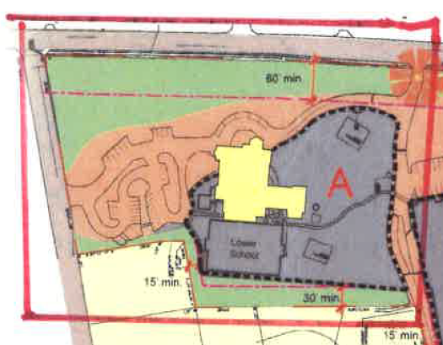

Slide 6
2. New athletic field between Wood Valley and Rilman Roads
Field is allowed under existing Agreement, but placement has been shifted.
Existing Master Plan defines permitted field area.
Rilman Rd. Properties required to keep R3 Residential zoning as long as Pace owns the properties.
Changing residential properties to institutional use not allowed.
Back property lines of residential properties would need to be moved closer to Rilman Rd.
Access from Rilman Rd. to new field not allowed under existing Agreement.

Slide 7
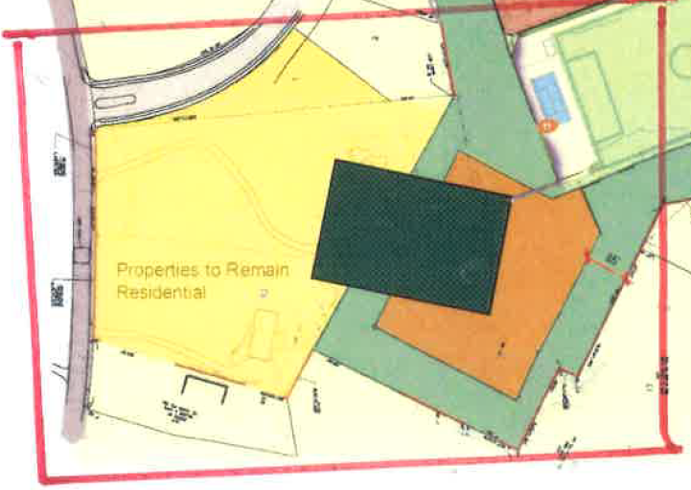

Slide 8
3. Existing soccer field
New tennis court and concrete surround, sidewalk along soccer field (soccer field will be shifted further East).
Soccer field required to remain pervious surface under existing Agreement; no paving.

Slide 9
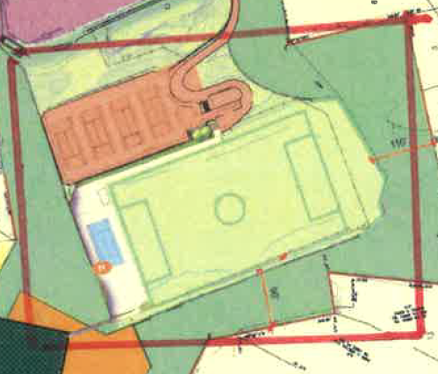

Slide 10
4. Lower Athletic Field behind school
New parking lot and 3 new buildings on east side of Lower Athletic Field behind school.
May only have parking below the existing field.
No paved surfaces permitted; surface required to remain pervious under existing Agreement.
No buildings allowed, only structures such as bleachers, signage, fencing under existing Agreement.
No lighting of field (other than pedestrian lighting) is allowed under existing Agreement.

Slide 11
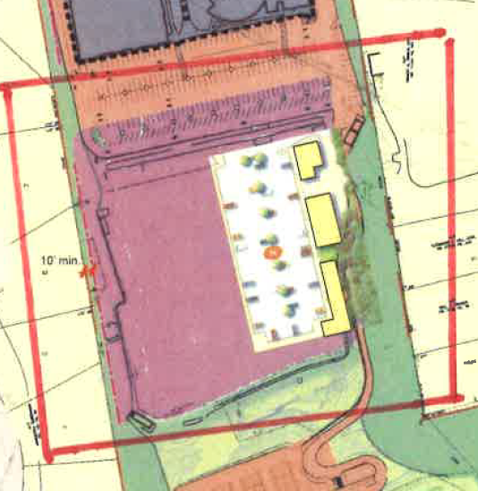

Slide 12
5. Pod C
Tear down both homes and build new institutional facility to include Natatorium and Wellness Center.
854 WPF (Headmaster’s home) may only be used for Headmaster’s home and related school functions.
340 WPF may be torn down and be used as screened parking for 30 spaces.
Changing properties from residential to institutional use not allowed under existing Agreement.

Slide 13
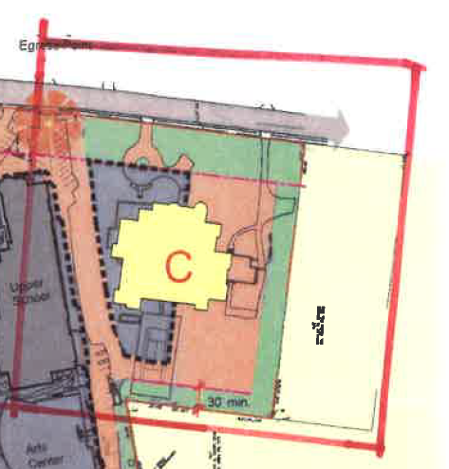

Slide 14
QUALIFIED OBJECTIONS
“Qualified Objections” shall be defined as objections based on the failure of Pace’s plans to include satisfactory provisions and arrangements with regard to the following issues:
(a) compliance and consistency with the other terms and conditions of [the 20 Year Agreement];
(b) the impact of drainage, drainage facilities and structures, finished grades, retaining walls, massing, and fencing on the adjacent properties and the surrounding neighborhood;
(c) ingress and egress to the Pace property and the proposed structures thereon, with particular reference to automotive and pedestrian safety and convenience, traffic flow and control, and access in case of fire or other catastrophe;
(d) off street parking and loading areas, with particular attention to the items referenced in (c) above;
(e) the location of refuse and service areas;
(f) the adequacy of buffering or screening to alleviate such potentially adverse effects on the adjacent properties and the surrounding neighborhood as may be created by the visibility of the proposed improvements, noise, glare, odor, lighting, signs or traffic;
(g) hours and manner of operations;
(h) the length of time regarding the duration of any requested permit, if any;
(i) tree preservation and replacement in accordance with the requirements of the City of Atlanta Tree Ordinance; and
(j) required yards and open space.

